Slide 1
Network - A basic guide
By Jitendra Singh Tomar

Slide 2
Index
Networking Devices
Common Networking Devices
IP addressing and Subnetting part
IP Address - IPv4 vs IPv6 Tutorial
Understanding IP Classes & Subnetting
The OSI reference model
What is IP Header?
Overview
Types of Networking
Network Topologies
Protocols
Network Media & Cabling
Crimping of twisted pair cable
Patch Panel

Slide 3
Introduction
The main purpose of network is to share the data and can be used to enhance the overall performance of some applications by distributing the computation tasks to various computers on the network.
The networking process also involves designing, implementing, upgrading, managing and working with networks and network technologies.

Slide 4
What is Computer Networking?
A computer network is a system that connects numerous independent computers in order to share information (data) and resources.
A computer network is a collection of two or more computer systems that are linked together.
A network connection can be established using either cable or wireless media.
Servers, networking hardware, personal computers, and other specialized or general-purpose hosts can all be nodes in a computer network.

Slide 5
What Do Computer Networks Do?
Computer Networks help in providing better connectivity that helps nowadays. Modern computer networks have the following functionality like
Computer Networks help in operating virtually.
Computer Networks integrate on a large scale.
Computer Networks respond very quickly in case of conditions change.
Computer Networks help in providing data security.

Slide 6
Criteria of a Good Network
Performance: It can be measured in many ways, including transmit time and response time.
Transit time is the amount of time required for a message to travel from one device to another.
The performance of the network depends on a number of factors, including the number of users, the type of medium & Hardware
Reliability: In addition to accuracy is measured by frequency of failure, the time it takes a link to recover from failure, and the network’s robustness in catastrophe.
Security: Network security issues include protecting data from unauthorized access, protecting data from damage and development, and implementing policies and procedures for recovery from breaches and data loss.

Slide 7
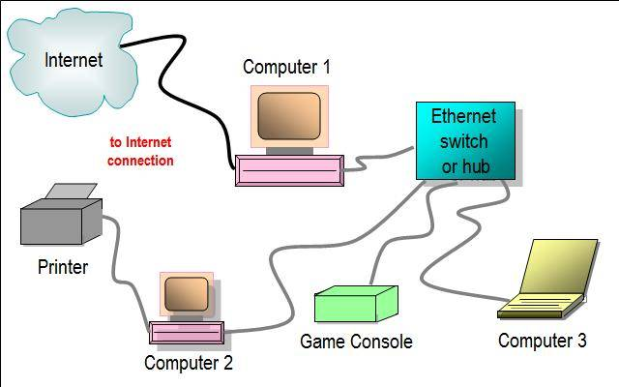
Purpose of Network
Networking is the practice of associating two or more computing devices together physically or logically for the purpose of sharing data and resources.

Slide 8
Goals of Computer Networking
Load sharing
Reduced costs
Reliability
Scalability
Communication and mail
Information Access
Entertainment
Social Networking

Slide 9
Types of Network - Based on the Communication Medium
Wired Network
Communication done in a wired medium. Copper wire, twisted pair, or fiber optic cables are all options.
A wired network employs wires to link devices to the Internet or another network, such as laptops or desktop PCs.
Wireless Network
“Wireless” means without wire, media that is made up of electromagnetic waves (EM Waves) or infrared waves.
Antennas or sensors will be present on all wireless devices.

Slide 10
Types of Network - Based on Area Covered
Local Area Network (LAN)
A LAN is a network that covers an area of around 10 kilometers.
Depending upon the needs of the organization, a LAN can be a single office, building, or Campus.
Metropolitan Area Network (MAN)
MAN refers to a network that covers an entire city.
For example: consider the cable television network.
Wide Area Network (WAN)
WAN refers to a network that connects countries or continents.
For example, the Internet allows users to access a distributed system called www from anywhere around the globe.

Slide 11
Types of Network - Based on Type of Architecture
P2P Networks
Computers with similar capabilities and configurations are referred to as peers.
The “peers” in a peer-to-peer network are computer systems that are connected to each other over the Internet.
Client-Server Networks
Each computer or process on the network is either a client or a server in a client-server architecture (client/server). The client asks for services from the server, which the server provides.
Servers are high-performance computers or processes that manage disc drives (file servers), printers (print servers), or network traffic (network servers)
Hybrid Networks
The hybrid model uses a combination of client-server and peer-to-peer architecture. Ex: Torrent.

Slide 12
Network Defined by Architecture
Two most common network types are peer-to-peer and client/server.
Peer–to– Peer- Since there is no dedicated server, all workstations are considered equal and any one of them can act as the client or the server depending on the need and request. Cost effective network solution.
Client/Server Topology – By accessing the server computer, the clients can also access the files and folders kept in the server. Main disadvantage of a client server model is, the server getting overloaded and slow when many clients trying to access the network at a same point of time.

Slide 13
Network Topologies
Physical Topology
Bus Topology
Star Topology
Mesh Topology
Ring Topology
Dual-ring topology
Hybrid Topology
The Hub and Spoke Topology

Slide 14
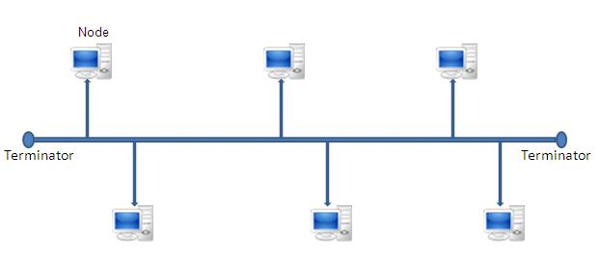
Bus Topology
Uses one single cable as a core line to connect all the systems and devices on a network together.

Slide 15
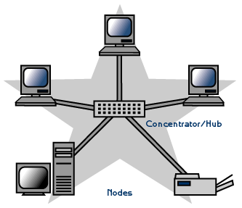
Star Topology
They are connected through one central device called a hub or a switch or a concentrator.

Slide 16
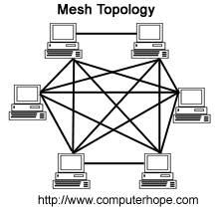
Mesh Topology
Even if one of the connections goes down, by using other connections a node can be alive on a network.

Slide 17
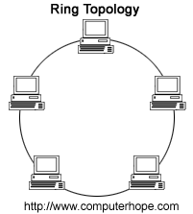
Ring Topology
A ring topology is where each node or device on the network connects to two other nodes.

Slide 18
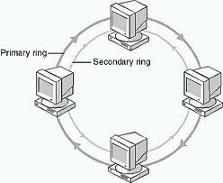
Dual-ring topology
Network redundant topology where nodes are connected using two concentric rings with four branches.

Slide 19
Networking Protocol
A network protocol is a set of rules that govern data communication between different devices in the network.
It determines
what is being communicated,
how it is being communicated, and
when it is being communicated.
It permits connected devices to communicate with each other, irrespective of internal and structural differences.

Slide 20
Networking Protocol
The protocols can be broadly classified into three major categories:
Network Communication
Network Management
Network Security

Slide 21
Networking Protocol - Network Communication
Hypertext Transfer Protocol (HTTP)
Transmission Control Protocol (TCP)
User Datagram Protocol (UDP)
Border Gateway Protocol (BGP)
Address Resolution Protocol (ARP)
Internet Protocol (IP)
Dynamic Host Configuration Protocol (DHCP)

Slide 22
Networking Protocol - Network Management
Internet Control Message Protocol (ICMP)
Simple Network Management Protocol (SNMP)
Gopher
File Transfer Protocol (FTP)
Post Office Protocol (POP3)
Telnet

Slide 23
Networking Protocol - Network Security
Secure Socket Layer (SSL)
Hypertext Transfer Protocol (HTTPS)
Transport Layer Security (TLS)
TLS 1.0 (deprecated)
TLS 1.5 (old applications)
TLS 2.0 (latest)

Slide 24
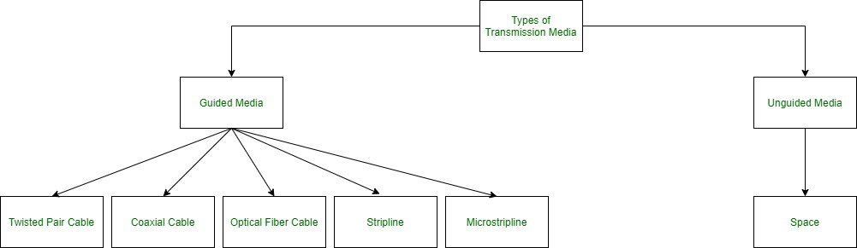
Network Media / Transmission Media

Slide 25
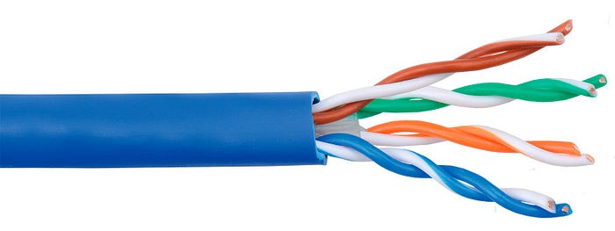
Unshielded Twisted Pair (UTP)

Slide 26
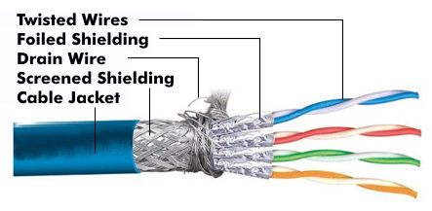
shielded twisted pair (STP)

Slide 27
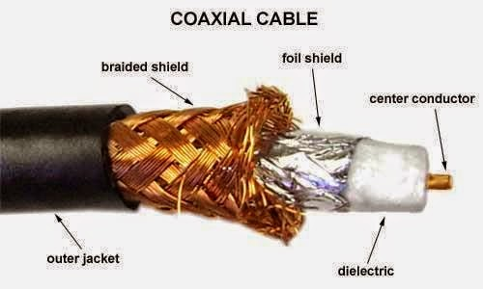
Coaxial cable

Slide 28
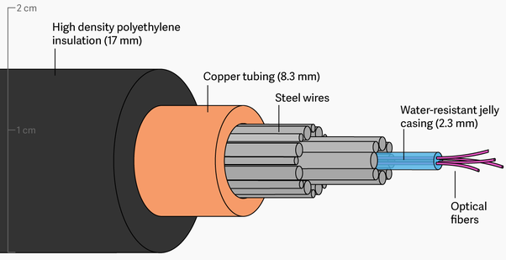
Optical fibre cable

Slide 29
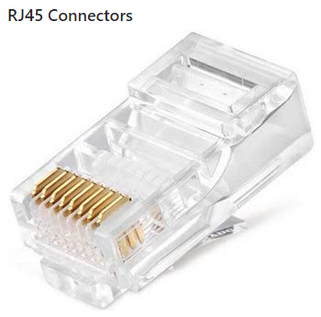


Crimping of twisted pair cable
https://docs.seattlecommunitynetwork.org/learn/cable-crimping.html

Slide 30
Networking Devices
NIC (Network Interface Card)
Repeater
Hub
Bridges
Switches
Routers
Gateways

Slide 31
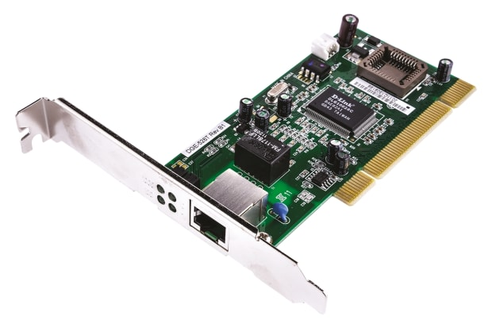
Networking Devices - NIC
A network card, often known as a network adapter or NIC (network interface card), is computer hardware that enables computers to communicate via a network.
It offers physical access to networking media and, in many cases, MAC addresses serve as a low-level addressing scheme.
Each network interface card has a distinct identifier. This is stored on a chip that is attached to the card.

Slide 32
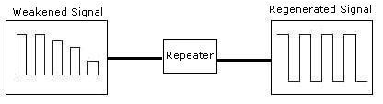
Networking Devices - Repeater
A repeater is an electrical device that receives a signal, cleans it of unwanted noise, regenerates it, and retransmits it at a higher power level or to the opposite side of an obstruction, allowing the signal to travel greater distances without degradation.
In the majority of twisted pair Ethernet networks, Repeaters are necessary for cable lengths longer than 100 meters in some systems. Repeaters are based on physics.

Slide 33
Networking Devices - HUB
A hub is a device that joins together many twisted pairs or fiber optic Ethernet devices to give the illusion of a formation of a single network segment.
A network hub is a relatively simple broadcast device.
Any packet entering any port is regenerated and broadcast out on all other ports, and hubs do not control any of the traffic that passes through them.
Packet collisions occur as a result of every packet being sent out through all other ports, substantially impeding the smooth flow of communication.

Slide 34
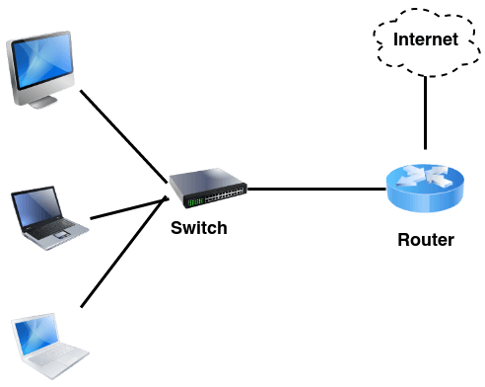
Networking Devices - Switches
A switch differs from a hub in that it only forwards frames to the ports that are participating in the communication, rather than all of the ports that are connected.
The collision domain is broken by a switch, yet the switch depicts itself as a broadcast domain. Frame-forwarding decisions are made by switches based on MAC addresses.

Slide 35
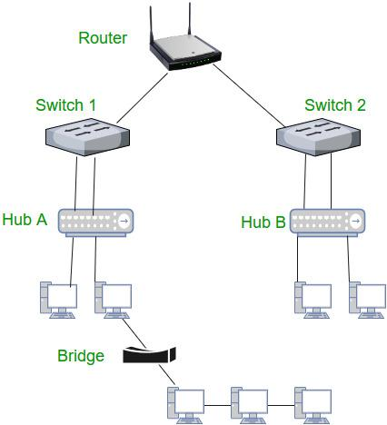
Networking Devices - Routers
Routers are networking devices that use headers and forwarding tables to find the optimal way to forward data packets between networks.
A router is a computer networking device that links two or more computer networks and selectively exchanges data packets between them.
A router can use address information in each data packet to determine if the source and destination are on the same network or if the data packet has to be transported between networks.
When numerous routers are deployed in a wide collection of interconnected networks, the routers share target system addresses so that each router can develop a table displaying the preferred pathways between any two systems on the associated networks.

Slide 36
IP addressing
Each device that uses a network receives an IP address, which is a special identifier number.
IP addresses are necessary for routing packets of data between devices and for enabling Internet communication between devices.
There are two primary forms of IP addresses
IPv4 and
IPv6

Slide 37
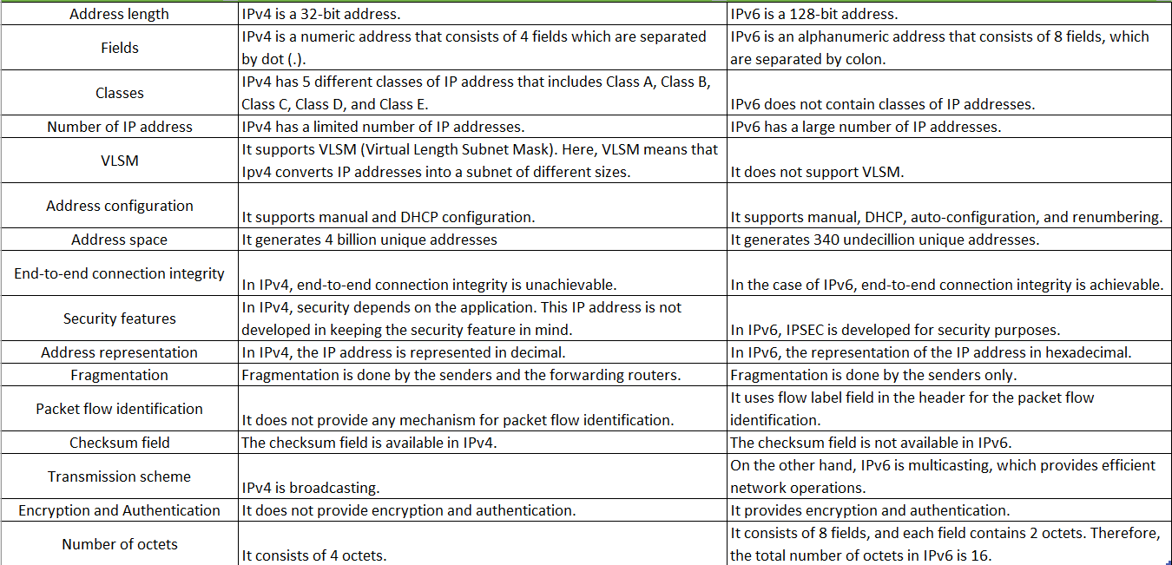
IPv4 & IPv6

Slide 38
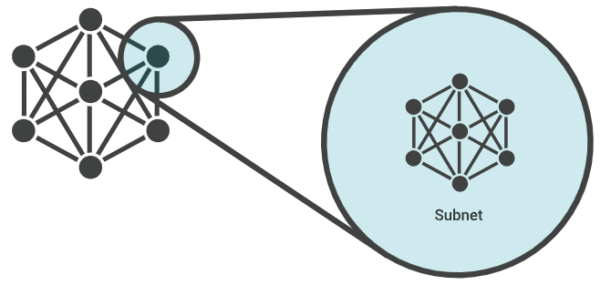
Subnetting
A network is divided into smaller subnetworks, or subnetworks, through the process known as a subnetwork.
The sub-network enables network managers to create more controllable and segmented networks for performance or security needs.
For example, a large enterprise could segment its network into subnetworks for multiple divisions or locations.

Slide 39
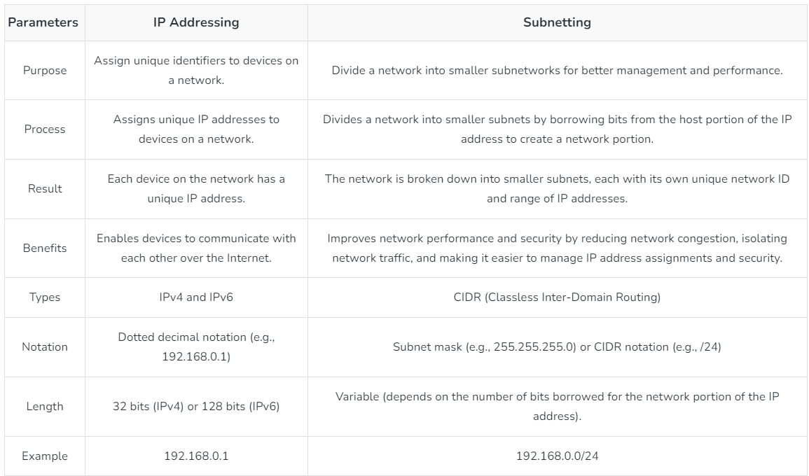
IP addressing and Subnetting

Slide 40
IPv4 Address classes
Class A (0-127)
Class B (128-191)
Class C (192-223)
Class D (224-239)
Class E (240-255)
Class A has 24 Host ID Bits
Class B has 16 Host ID Bits
Class C has 8 Host ID Bits

Slide 41
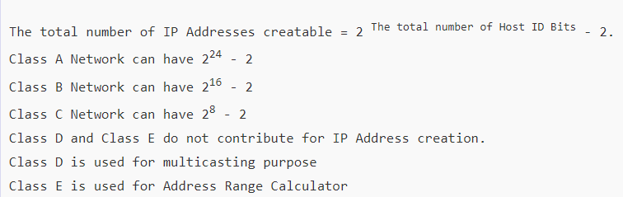
The number of usable IP Addresses that can be created is

Slide 42
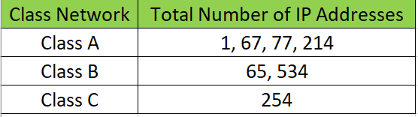
Total Ip addresses within a network

Slide 43
The OSI reference model
OSI stands for Open Systems Interconnection.
It is a 7-layer architecture with each layer having specific functionality to perform.
All these 7 layers work collaboratively to transmit the data from one person to another across the globe. OSI model was developed by ISO – ‘International Organization for Standardization‘, in the year 1984.
The purpose of the OSI reference model is to guide technology vendors and developers so the digital communications products and software programs they create can interoperate and to promote a clear framework that describes the functions of a networking or telecommunications system that's in use.

Slide 44
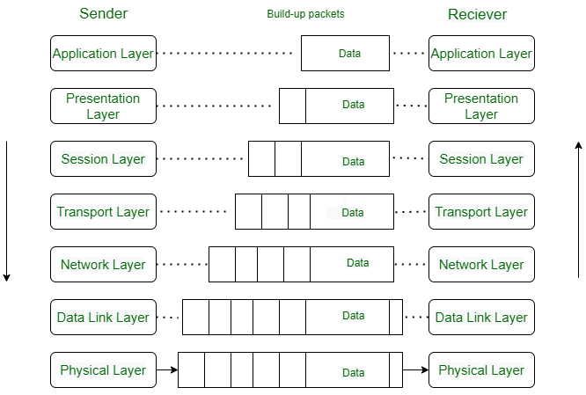
OSI Model

Slide 45
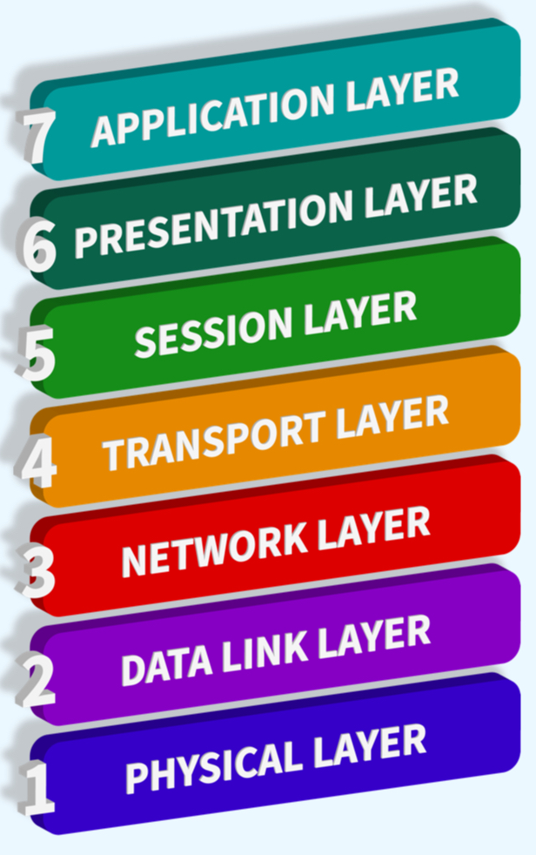
layers of the OSI Model
Physical Layer
Data Link Layer
Network Layer
Transport Layer
Session Layer
Presentation Layer
Application Layer

Slide 46
TCP/IP Model
TCP/IP was designed and developed by the Department of Defense (DoD) in the 1960s and is based on standard protocols.
It stands for Transmission Control Protocol/Internet Protocol.
The TCP/IP model is a concise version of the OSI model.
It contains four layers, unlike the seven layers in the OSI model.

Slide 47
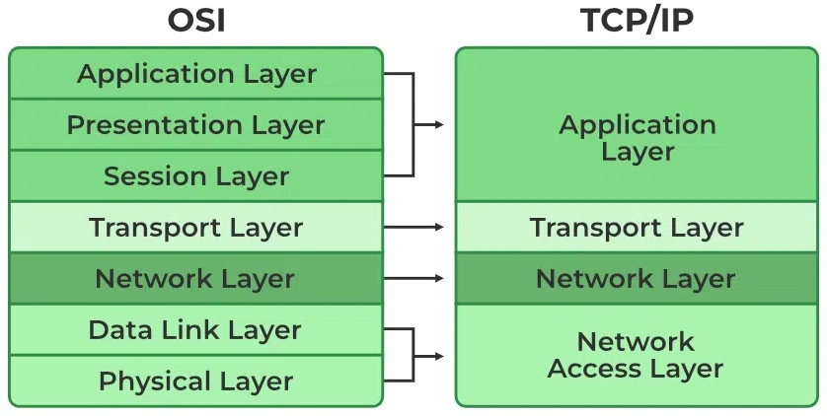
TCP/IP Model

Slide 48
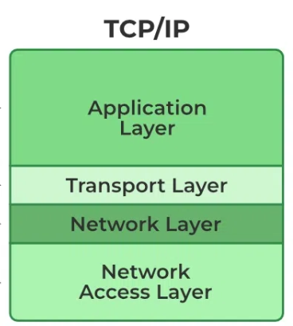
Layers of TCP/IP Model
Application Layer
Transport Layer(TCP/UDP)
Network/Internet Layer(IP)
Data Link Layer (MAC)
Physical Layer

